Slide 1
Effect of Low Crude Oil Prices on the Chemical & Petrochemical Industries A Paper presented by Abduljabbar M. Alwaggaa (B.SC,M.Sc), Oil Expert Zaid Hammo (B.Sc), Oil Expert To Arab Federation for
Chemical & Petrochemical Industries
Amman- 17th February , 2016

Slide 2
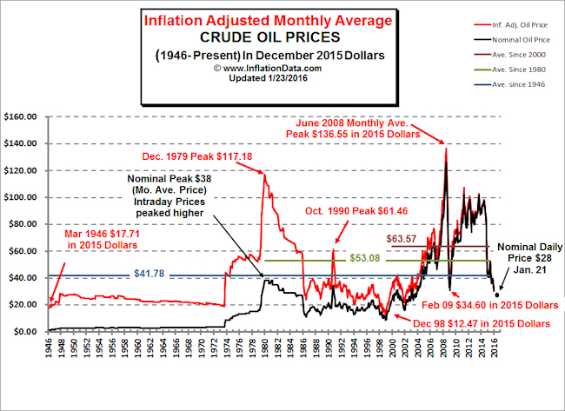
Crude Oil Price Profile 1

Slide 3
Crude Oil Price Profile 2
Nominal average yearly price for 14 years 1946-1959 (IOC Era)rose only from $1.63 to $3.0.
1960-1981 it started to climb up to $35.75 with peak of $38 in Dec. 1979 with interlaced relative maximums & minimums, but It took a dive down to $14.44 in 1986, back to rise to $23.19 in 1991

Slide 4
Crude Oil Price Profile 3
Going down to 11.91 in 1998 and then rising quite sharply to a record level of $91.48 in 2008 with peak value of $126.in June of that year.
Then a decline to present day price of $30 on the 10th Feb 2016

Slide 5
Salient Features of the profile 1
In the era Pre National Oil Companies mainly 1946 to 1972 (26 year span) where control of oil price was totally under the 7 Majors and no other market dynamic has an effect on pricing, where by the IOCs operated under a model of supply and demand, so balanced & with price fixed that no room for other investors to share market with them. During that period the price changed from $2.16 to $3.6 (nominal Value).

Slide 6
Salient Features of the profile 2
The 2nd Era between 1972 to 1986, price change drastically it shots from $3.6 to a peak of $38 on Dec.1979 (more than 10folds))

Slide 7
Salient Features of the profile 3
Price dropped to a record low of less than $10 during1986.The reason behind this is; years of high prices induced huge investment & hence large production capacity creating market glut. (western politics created this dynamics to counter balance to Arab embargo in early 1970s and to nullify its effect

Slide 8
Salient Features of the profile 4
The present catastrophic fall in crude oil prices since the fourth quarter of 2014,can be attributed to following factors
High Oil Prices since 2005 until the mid year of 2014 led to investment in increasing production capacity and introducing new oil from various conventional and non conventional sources introducing market glut .
China’s demand to energy and raw material in general is week due to moderate growth of its economy (China energy consumption equals 20% of the total world).

Slide 9
Salient Features of the profile 5
3. Sustained production despite gradual drop in oil prices from some reservoirs & sources of high production costs (ranging from $30 to $100 such as off shore, sand oil, shale & others ) .
4. Political exertion by USA & Allies to weaken Russian & some others economies by adopting the policies of “Market share "rather than price

Slide 10
Is there a quick FIX for the present Situation? 1
The obvious answer is yes if a sizable number of producers agreed simultaneously to cut down production & trade it for higher price.
But this was proven to un attainable, as bilateral & group discussions among producers did not succeed in bringing producers to act together.

Slide 11
Is there a quick FIX for the present Situation? 2
Could such fix come from one or two producers ? No! why because the excess global production capacity, would mean if a lone producer cut production by Xbbl/d to raise price by $Y/bbl other producers will jump to fill in, so the next day this lone producer has to cut by another Xbbl/d and so on… no such wise producer will ever likely to do so

Slide 12
Are Present Prices sustainable? 1
No! Why?
For the following restraints prevailing under such prices:
High cost production sources started shutting down .
Investments in maintaining other high cost production sources are being held back so further production is withdrawn.
Investment to bring new oil is held back

Slide 13
Are Present Prices sustainable? 2
Also glut in the oil market is not due to structural change in the pattern of consumption, why? the global demand for Oil is in the increase as in the year of20015 demand in USA, China, Russia, European Union has increased. If this is coupled with lost production from high cost source the glut will be removed giving way to process of high price cycle

Slide 14
Price Take off, When?
Since the glut in the oil market is not due to structural change in the pattern of consumption & by reviewing the historical pattern of oil prices in the last decade we see that periods between relative maximum and relative minimum are getting shorter.
Analysts expect a price around $60 to $70 is possible toward the 4th quarter of this year

Slide 15
The positive effect of low oil price on Arab Ch. & Petroch. Industry

Slide 16
Positive- 1
تبني بعض الدول العربيه لقرار منظمة "الأوبك“ المحافظه على الحصه في السوق بدلا عن الدفاع عن الاسعار يعد وللمرة الاولى التخلي عن سياسة التضحيه بمصالح المنتجين العرب لصالح المنتجين غير العرب وهو بالنتيجه سيكون لصالح الدول العربيه المنتجه، حيث في الامد القريب والمتوسط ستبقى الدول العربيه التي في الغالب تتمتع بأسعار وتكاليف إنتاج واطئه وستخرج كثير من الحقول والمصادر عالية التكاليف تدريجيا من الاسواق .

Slide 17
Positive-2
إن بسياسة الإنتاج غير المحدد بحصص اوبك يحتم على الدول العربيه زيادة الجهود لبناء المصافي المتطوره وتصفية أكبر قدر من نفوطها لسد حاجاتها الذاتيه ولتوفير المتجات الداخله في الصناعات الكيمياويه والبتروكيمياويه محليا مما يدعم إستقطاب الإستثمار الوطني والاجنبي لتلك المشاريع ويزيد من الاسواق لنفوطها.

Slide 18
Positive-3
إنخفاض أسعار النفط الخام يعطي قيمه إقتصاديه مضافه لإنتاج الغازالعربي وتصنيعه (كون أسعار ألغاز لم تعد مرتبطه بأسعار النفط الخام) وسيدفع بإتجاه إستثماره، لكون إستثمار الغاز في بعض الدول العربيه لم يأخذ إلا إهتماما ثانويا في صناعتها النفطيه أفقد إقتصاد تلك الدول من فرص توفير منتجات صناعة الغاز (الإيثان والبنزين الطبيعي) لتطوير الصناعات الكيمياويه والبتروكيمياويه وصناعة الاسمده، وسيحرر ايضا منتجات بتروليه من كونها تستعمل حاليا لأغراض الطاقه ويوفرها لاغراض الصناعه الكيمياويه والبتروكيمياويه.

Slide 19
Positive -4
إن إنخفاض أسعار النفط الخام سيخفف الضغط في المدى المتوسط والبعيد على إستعمالات النفط بسبب المتطلبات البيئيه العالميه كما جاء في مؤتمر باريس.

Slide 20
Positive - 5
إنخفاض أسعار النفط بشكل سريع (ولكنه غير مفاجئ لكثير من المحللين) منذ الربع الرابع لعام 2014 قد كشف عورة الحكومات الفاسده التي لم تستثمر العوائد العاليه في السنوات التي سبقت نزول الاسعار لتطوير مصادر دخل أخرى للاقتصاد الوطني بل وظفت ذلك الدخل في إنغماس السياسيين في مستنقع الفساد. لقد أحدث الإنخاض وعيا لدى الشعوب لم يسبق له مثيل في المطالبه لتنويع الدخل الوطني لا سيما وان إفلاس بعض الحكومات بسبب الجهل في إدارة الموارد قد أوصل المواطن الى فقدان الدعم المادي على حاجاته في بعض الدول المنتجه وصعوبة حصوله على لقمة العيش في بعض الدول الاخرى.

