Slide 1
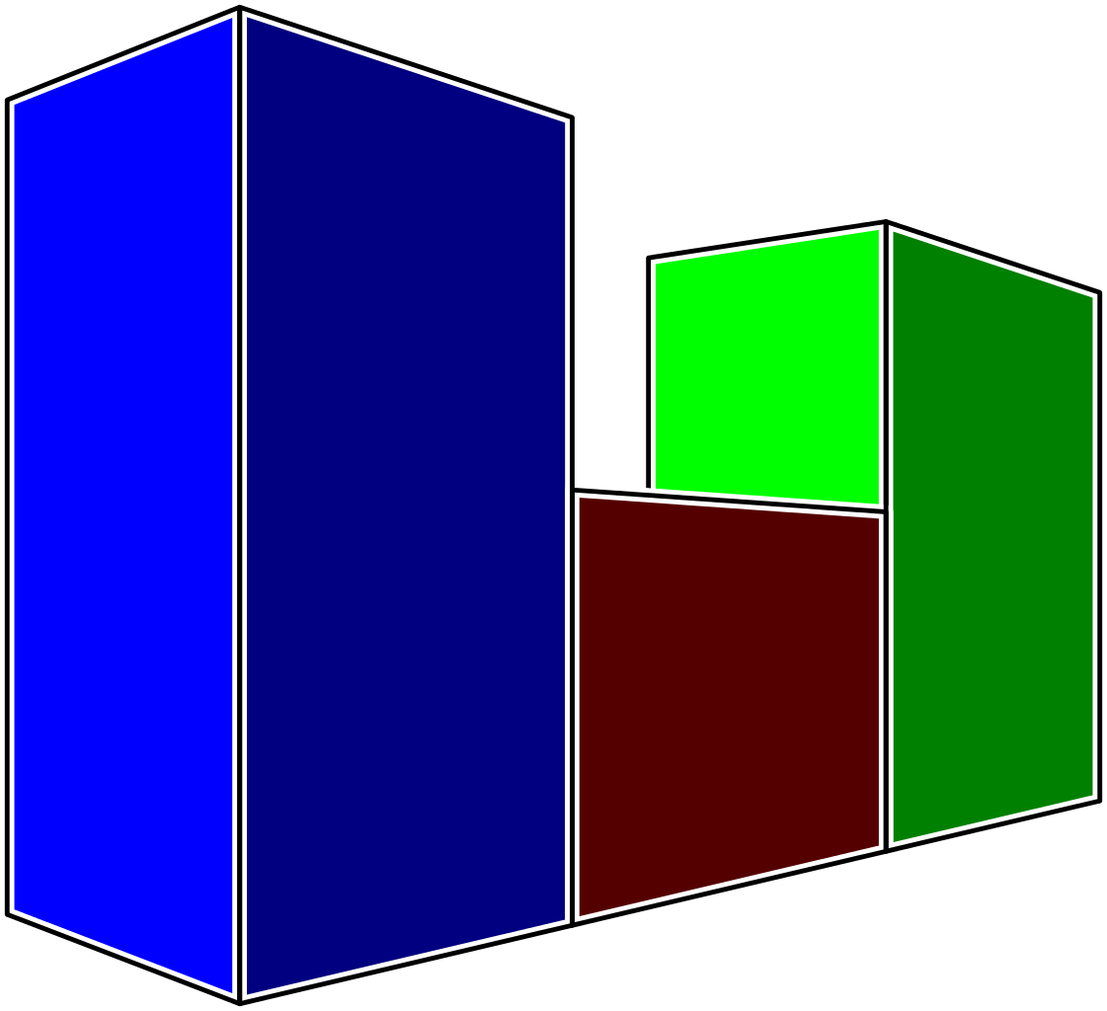

Effect of Low Crude Oil Prices
on the Chemical & Petrochemical
Industries
A Paper presented by
Abduljabbar M. Alwaggaa (B.SC,M.Sc), Oil Expert-part1
Zaid Hammo (B.Sc), Oil Expert-part2
To
Arab Federation for
Chemical & Petrochemical Industries
Amman- 17th February , 2016

Slide 2
Part 2
Crud Oil Price Impact
On
Petrochemical Industry
Presented
by
Zaid Hammo

Slide 3
Feedstock represents only 2% of each barrel of crude
Crude oil feedstocks represent around 70%
Alternative sources feedstocks around 30%
Cost of feedstocks represents 45-55% of petchem. proj.
Direct relation between crude & feedstocks prices (regional)
Refinery margins depends on product/feedstock demand
Transport cost, competition, currency exchange.
Resilience of petrochemical industry will shape behavior
Behavior is country/region dependent
Shape of forecast recovery
Turning point /decision making

Slide 5
Ethylene Cracking

Slide 6
$300/tonne
Floor price

Slide 7
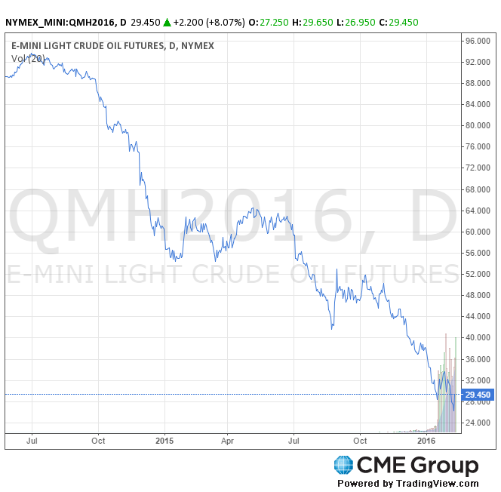
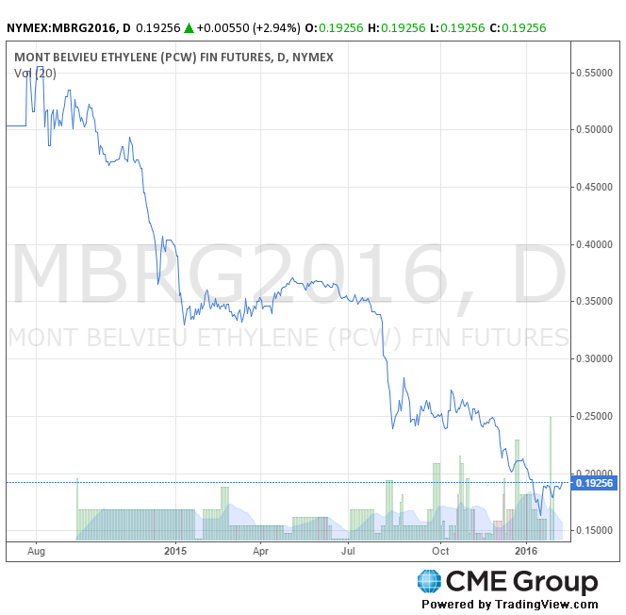
Wti futures curve $/bbl
Ethylene futures curve c/lb

Slide 9
Crude Price Recovery terms (short, medium & long)

Slide 10
Ethylene Capacity (2008)
World Capacity=120 million tonnes
ME Capacity=10.4 million tonnes

Slide 11
Most Feedstocks production in the ME region use gas
Gas price in the ME is not related to crude oil price
While in other regions gas price is related to crude oil price
In other words competition with ME producers much easier now

Slide 12
Some of the Ethylene producers in the ME

Slide 13
Conclusions
It was a historical opportunity to invest in the ME when high crude oil prevailed.
Impact of crude oil prices on petrochemical industry is country/region dependent.
However, most of the regions affected other than the ME region.
Refinery margins also been affected, still it depends on a certain product demand.
Environmental regulations, Energy alternatives, technology development, demand.
Competition now is tougher between regions depending on transport cost.
ME should think of attracting investments for new projects during this period
Strategic location of the ME make it easier to compete others

Slide 14
Thank you

